Slide 1
Lecture 9, and 10
Number theory
Part II: Primes and Related Congruence Equations
Copyright © The McGraw-Hill Companies, Inc. Permission required for reproduction or display.
9.<number>

Slide 2
Objectives
❏ To introduce prime numbers and their applications
in cryptography.
❏ To discuss some primality test algorithms and their
efficiencies.
❏ To discuss factorization algorithms and their
applications in cryptography.
❏ To describe the Chinese remainder theorem and its
application.
❏ To introduce quadratic congruence.
❏ To introduce modular exponentiation and
logarithm.
9.<number>

Slide 3
PRIMES
Asymmetric-key cryptography uses primes extensively. The topic of primes is a large part of any book on number theory. This section discusses only a few concepts and facts to pave the way for Chapter 10.
Topics discussed in this section:
Definition
Cardinality of Primes
Checking for Primeness
Euler’s Phi-Function
Fermat’s Little Theorem
Euler’s Theorem
Generating Primes
9.<number>

Slide 4
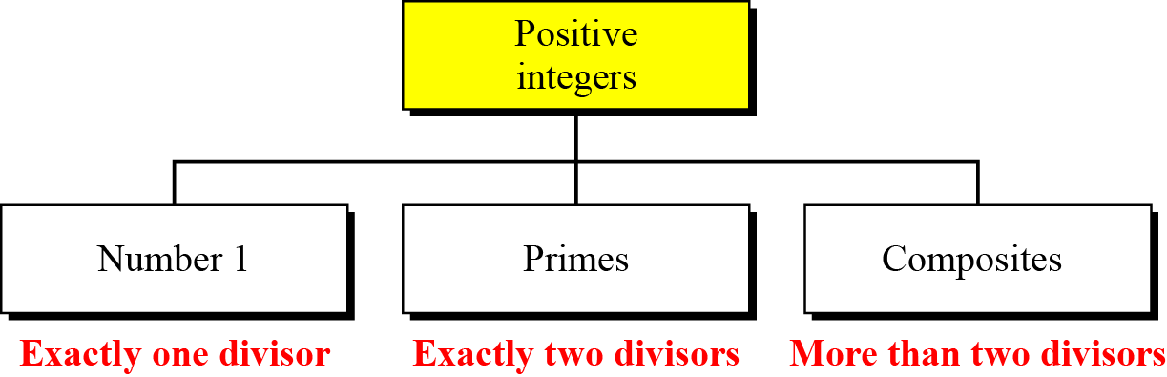

Definition
Three groups of positive integers
Note
A prime is divisible only by itself and 1.
9.<number>

Slide 5
Continued
Example
What is the smallest prime?
Solution
The smallest prime is 2, which is divisible by 2 (itself) and 1.
Example
List the primes smaller than 10.
Solution
There are four primes less than 10: 2, 3, 5, and 7. It is interesting to note that the percentage of primes in the range 1 to 10 is 40%. The percentage decreases as the range increases.
9.<number>

Slide 6
Cardinality of Primes
Infinite Number of Primes
Note
There is an infinite number of primes.
Number of Primes
9.<number>

Slide 7
Continued
Example
As a trivial example, assume that the only primes are in the set
{2, 3, 5, 7, 11, 13, 17}. Here P = 510510 and P + 1 = 510511. However, 510511 = 19 × 97 × 277; none of these primes were in the
original list. Therefore, there are three primes greater than 17.
Example
Find the number of primes less than 1,000,000.
Solution
The approximation gives the range 72,383 to 78,543. The actual number of primes is 78,498.
9.<number>

Slide 8

Checking for Primeness
Given a number n, how can we determine if n is a prime? The answer is that we need to see if the number is divisible by all primes less than
We know that this method is inefficient, but it is a good start.
9.<number>

Slide 9
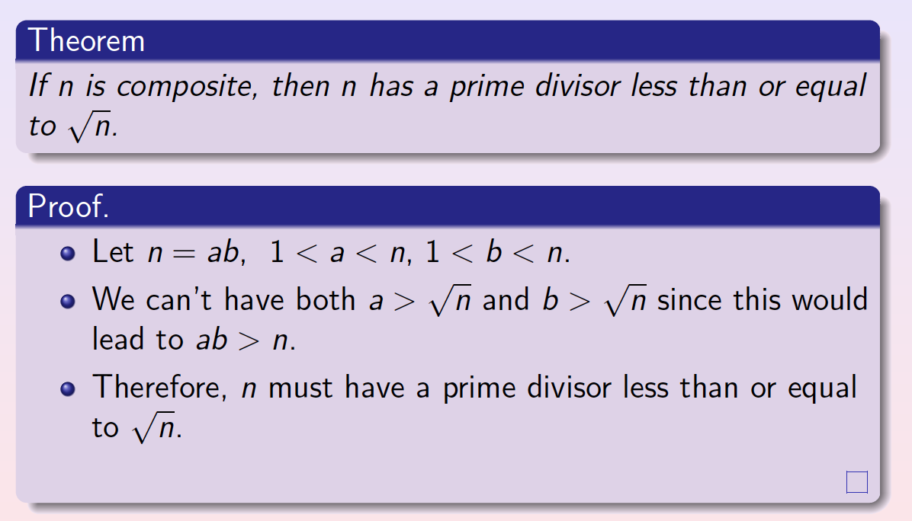
9.<number>

Slide 10
9.1.3 Continued
Example 9.5
Is 97 a prime?
Solution
The floor of √97 = 9. The primes less than 9 are 2, 3, 5, and 7. We need to see if 97 is divisible by any of these numbers. It is not, so 97 is a prime.
Example 9.6
Is 301 a prime?
Solution
The floor of √301 = 17. We need to check 2, 3, 5, 7, 11, 13, and 17. The numbers 2, 3, and 5 do not divide 301, but 7 does. Therefore 301 is not a prime.
9.<number>

Slide 11
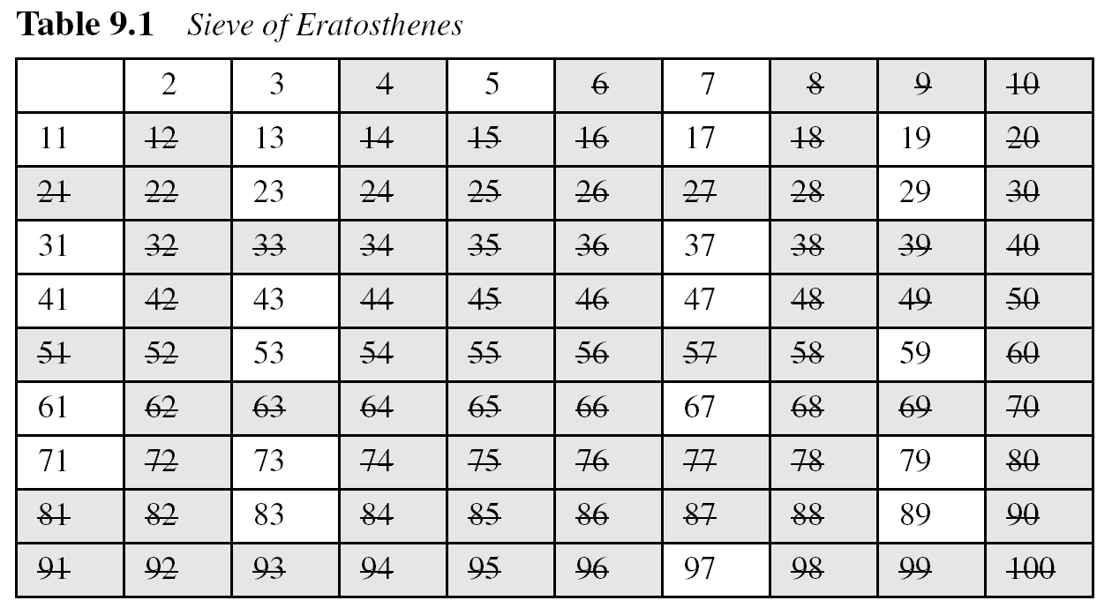
9.1.3 Continued
Sieve of Eratosthenes
9.<number>

Slide 12
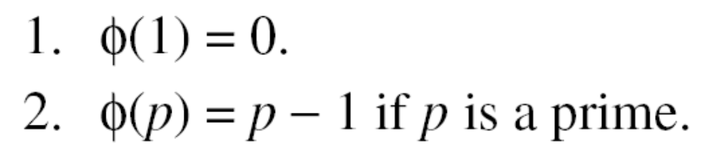
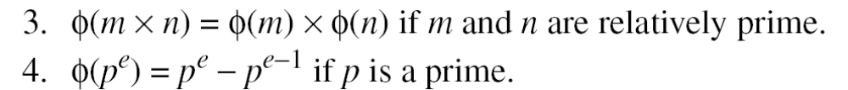
Euler’s Phi-Function
Euler’s phi-function, φ (n), which is sometimes called the
Euler’s totient function plays a very important role in cryptography. It counts the positive integers up to a given integer n that are relatively prime to n.
9.<number>

Slide 13
Continued
We can combine the above four rules to find the value of φ(n). For example, if n can be factored as
n = p₁^{e1} × p₂^{e2} × … × p_{k}^{ek}
then we combine the third and the fourth rule to find
Note
The difficulty of finding φ(n) depends on the difficulty of finding the factorization of n.
9.<number>

Slide 14
Continued
Example
What is the value of φ(13)?
Solution
Because 13 is a prime, φ(13) = (13 −1) = 12.
Example
What is the value of φ(10)?
Solution
We can use the third rule: φ(10) = φ(2) × φ(5) = 1 × 4 = 4, because 2 and 5 are primes.
9.<number>

Slide 15
Continued
Example
What is the value of φ(240)?
Solution
We can write 240 = 2⁴ × 3¹ × 5¹. Then
φ(240) = (2⁴ −2³) × (3¹ − 3⁰) × (5¹ − 5⁰) = 64
Example
Can we say that φ(49) = φ(7) × φ(7) = 6 × 6 = 36?
Solution
No. The third rule applies when m and n are relatively prime. Here 49 = 7². We need to use the fourth rule: φ(49) = 7² − 7¹ = 42.
9.<number>

Slide 16
Continued
Example
What is the number of elements in Z₁₄*?
Solution
The answer is φ(14) = φ(7) × φ(2) = 6 × 1 = 6. The members are 1, 3, 5, 9, 11, and 13.
Note
Interesting point: If n > 2, the value of φ(n) is even.
9.<number>

Slide 17
Fermat’s Little Theorem
First Version
a^{p − 1} ≡ 1 mod p
Second Version
a^{p} ≡ a mod p
9.<number>

Slide 18
Continued
Example
Find the result of 6¹⁰ mod 11.
Solution
We have 6¹⁰ mod 11 = 1. This is the first version of Fermat’s little theorem where p = 11.
Example
Find the result of 3¹² mod 11.
Solution
Here the exponent (12) and the modulus (11) are not the same. With substitution this can be solved using Fermat’s little theorem.
9.<number>

Slide 19
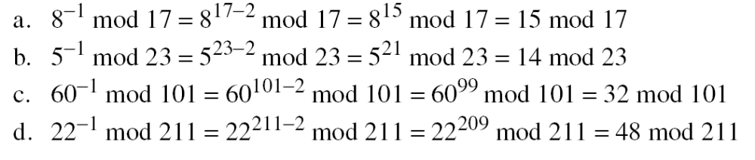
Continued
Multiplicative Inverses
a⁻¹ mod p = a ^{p − 2} mod p
Example
The answers to multiplicative inverses modulo a prime can be found without using the extended Euclidean algorithm:
9.<number>

Slide 20
Euler’s Theorem
First Version
a^{φ(n)} ≡ 1 (mod n)
Second Version
a ^{k × φ(n) + 1} ≡ a (mod n)
Note
The second version of Euler’s theorem is used in the RSA cryptosystem in Chapter 10.
9.<number>

Slide 21
Continued
Example
Find the result of 6²⁴ mod 35.
Solution
We have 6²⁴ mod 35 = 6^{φ(35)} mod 35 = 1.
Example
Find the result of 20⁶² mod 77.
Solution
If we let k = 1 on the second version, we have
20⁶² mod 77 = (20 mod 77) (20^{φ(77)} ⁺ ¹ mod 77) mod 77
= (20)(20) mod 77 = 15.
9.<number>

Slide 22
Continued
Multiplicative Inverses
Euler’s theorem can be used to find multiplicative inverses modulo a composite.
a⁻¹ mod n = a^{φ(n)−1} mod n
9.<number>

Slide 23
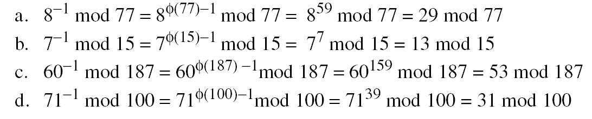
Continued
Example
The answers to multiplicative inverses modulo a composite can be found without using the extended Euclidean algorithm if we know the factorization of the composite:
9.<number>

Slide 24
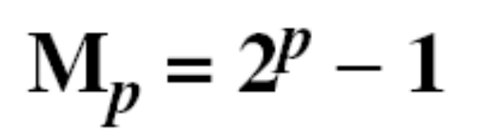
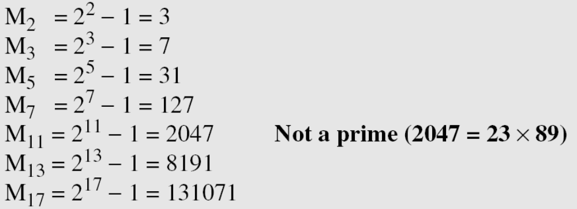
Generating Primes
Mersenne Primes
Note
A number in the form M_{p} = 2^{p} − 1 is called a Mersenne number and may or may not be a prime.
9.<number>

Slide 25

Continued
Fermat Primes
F₀ = 3 F₁ = 5 F₂ = 17 F₃ = 257 F₄ = 65537
F₅ = 4294967297 = 641 × 6700417 Not a prime
9.<number>

Slide 26
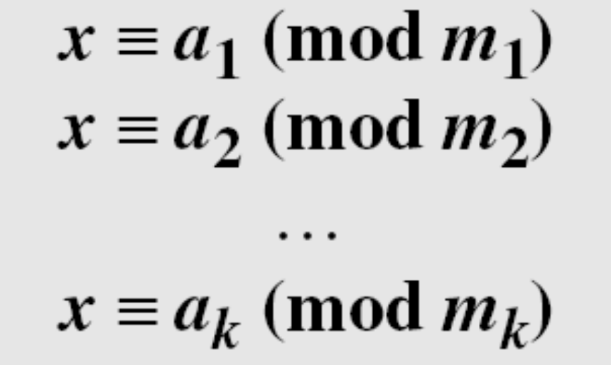
CHINESE REMAINDER THEOREM
The Chinese remainder theorem (CRT) is used to solve a set of congruent equations with one variable but different moduli, which are relatively prime, as shown
below:
9.<number>

Slide 27
Continued
Solution To Chinese Remainder Theorem
1. Find M = m₁ × m₂ × … × m_{k}. This is the common modulus.
2. Find M₁ = M/m₁, M₂ = M/m₂, …, M_{k} = M/m_{k}.
3. Find the multiplicative inverse of M₁, M₂, …, M_{k} using the
corresponding moduli (m₁, m₂, …, m_{k}). Call the inverses
M₁⁻¹, M₂⁻¹, …, M_{k} ⁻¹.
4. The solution to the simultaneous equations is
9.<number>

Slide 28
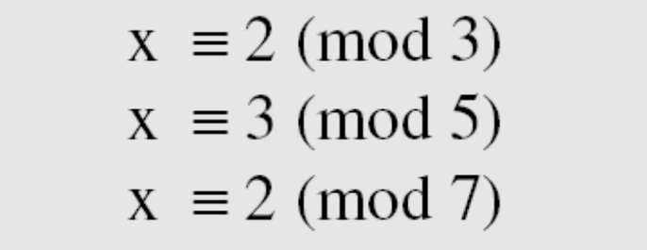
Continued
Example
The following is an example of a set of equations with different moduli:
The solution to this set of equations is given in the next section; for the moment, note that the answer to this set of equations is x = 23. This value satisfies all equations: 23 ≡ 2 (mod 3), 23 ≡ 3 (mod 5), and 23 ≡ 2 (mod 7).
9.<number>

Slide 29
Continued
Example
Find the solution to the simultaneous equations:
Solution
We follow the four steps.
1. M = 3 × 5 × 7 = 105
2. M₁ = 105 / 3 = 35, M₂ = 105 / 5 = 21, M₃ = 105 / 7 = 15
3. The inverses are M₁⁻¹ = 2, M₂⁻¹ = 1, M₃ ⁻¹ = 1
4. x = (2 × 35 × 2 + 3 × 21 × 1 + 2 × 15 × 1) mod 105 = 23 mod 105
9.<number>

Slide 30
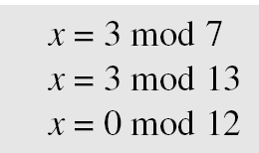
Continued
Example
Find an integer that has a remainder of 3 when divided by 7 and 13, but is divisible by 12.
Solution
This is a CRT problem. We can form three equations and solve them to find the value of x.
If we follow the four steps, we find x = 276. We can check that
276 = 3 mod 7, 276 = 3 mod 13 and 276 is divisible by 12 (the quotient is 23 and the remainder is zero).
9.<number>

Slide 31
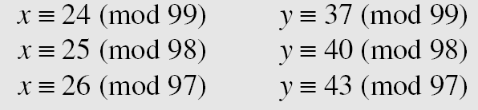
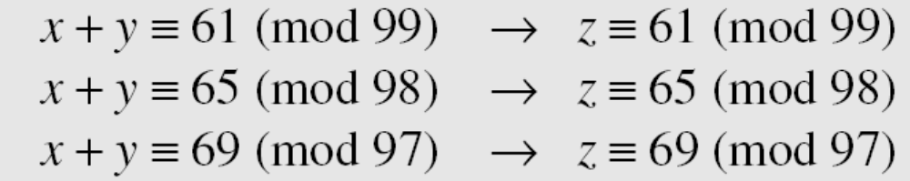
Continued
Example
Assume we need to calculate z = x + y where x = 123 and y = 334, but our system accepts only numbers less than 100.
Adding each congruence in x with the corresponding congruence in y gives
Now three equations can be solved using the Chinese remainder theorem to find z. One of the acceptable answers is z = 457.
9.<number>

Slide 32
QUADRATIC CONGRUENCE
In cryptography, we also need to discuss quadratic congruence⎯that is, equations of the form
a₂x² + a₁x + a₀ ≡ 0 (mod n). We limit our discussion to quadratic equations in which a₂ = 1 and a₁ = 0, that is equations of the form
Cable companies are now competing with telephone companies for the residential customer who wants high-speed data transfer. In this section, we briefly discuss this technology.
x² ≡ a (mod n).
Topics discussed in this section:
Quadratic Congruence Modulo a Prime
Quadratic Congruence Modulo a Composite
9.<number>

Slide 33
Quadratic Congruence Modulo a Prime
We first consider the case in which the modulus is a prime.
Example
The equation x² ≡ 3 (mod 11) has two solutions, x ≡ 5 (mod 11) and x ≡ −5 (mod 11). But note that −5 ≡ 6 (mod 11), so the solutions are actually 5 and 6. Also note that these two solutions are incongruent.
Example
The equation x² ≡ 2 (mod 11) has no solution. No integer x can be found such that its square is 2 mod 11.
9.<number>

Slide 34
Quadratic Residues and Nonresidue
In the equation x² ≡ a (mod p), a is called a quadratic residue (QR) if the equation has two solutions; a is called quadratic nonresidue (QNR) if the equation has no solutions.
For example, 4^2=6 (mod 10), so 6 is a quadratic residue (mod 10). The entire set of quadratic residues (mod 10) are given by 1, 4, 5, 6, and 9, since
1^2=1 (mod 10) 2^2=4 (mod 10) 3^2=9 (mod 10)
4^2=6 (mod 10) 5^2=5 (mod 10) 6^2=6 (mod 10)
7^2=9 (mod 10) 8^2=4 (mod 10) 9^2=1 (mod 10),
So, making the numbers 2, 3, 7, and 8 the quadratic nonresidues (mod 10).
Note: symmetry (p-x)^2=x^2 (mod p) and 0<x<=|_p/2_|, where |_x_| is the floor function
9.<number>

Slide 35
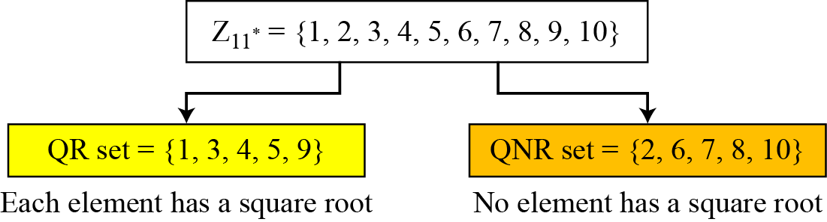
Continued
Example
There are 10 elements in Z₁₁*. Exactly five of them are quadratic residues and five of them are nonresidues. In other words, Z₁₁* is divided into two separate sets, QR and QNR, as shown in Figure 9.4.
Figure Division of Z₁₁* elements into QRs and QNRs
9.<number>

Slide 36
Continued
Euler’s Criterion
a. If a^{(p−1)/2} ≡ 1 (mod p), a is a quadratic residue
modulo p.
b. If a^{(p−1)/2} ≡ −1 (mod p), a is a quadratic nonresidue modulo p.
Example
To find out if 14 or 16 is a QR in Z₂₃*, we calculate:
14 ^{(23−1)/2} mod 23 → 22 mod 23 → −1 mod 23 nonresidue
16 ^{(23−1)/2} mod 23 → 16¹¹ mod 23→ 1 mod 23 residue
9.<number>

Slide 37
Continued
Solving Quadratic Equation Modulo a Prime
Special Case: p = 4k + 3
9.<number>

Slide 38
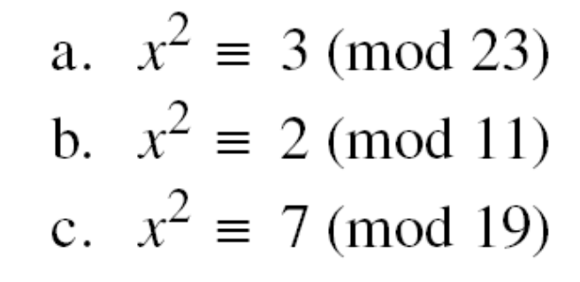
Continued
Example
Solve the following quadratic equations:
Solutions
x ≡ ± 16 (mod 23) √3 ≡ ± 16 (mod 23).
b. There is no solution for √2 in Z11.
c. x ≡ ± 11 (mod 19). √7 ≡ ± 11 (mod 19).
9.<number>

Slide 39
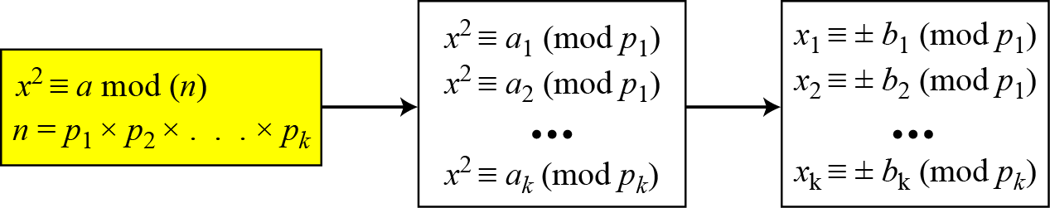
Quadratic Congruence Modulo a Composite
Figure Decomposition of congruence modulo a composite
9.<number>

Slide 40
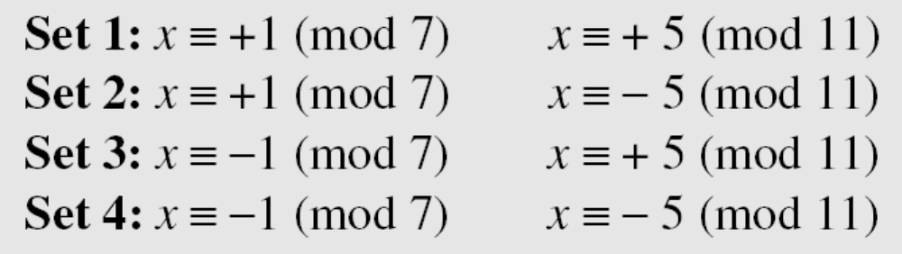
Continued
Example
Assume that x² ≡ 36 (mod 77). We know that 77 = 7 × 11. We can write
The answers are x ≡ +1 (mod 7), x ≡ − 1 (mod 7), x ≡ + 5 (mod 11), and x ≡ − 5 (mod 11). Now we can make four sets of equations out of these:
The answers are x = ± 6 and ± 27.
9.<number>

Slide 41
Continued
Complexity
How hard is it to solve a quadratic congruence modulo a composite? The main task is the factorization of the modulus. In other words, the complexity of solving a quadratic congruence modulo a composite is the same as factorizing a composite integer. As we have seen, if n is very large, factorization is infeasible.
Note
Solving a quadratic congruence modulo a composite is as hard as factorization
of the modulus.
9.<number>

Slide 42
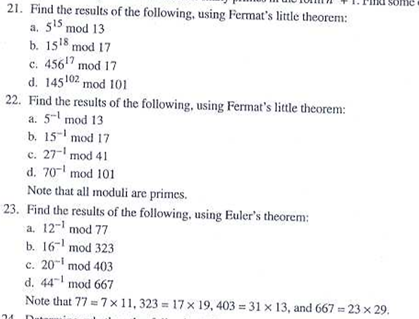
Home Work
9.<number>

Slide 43

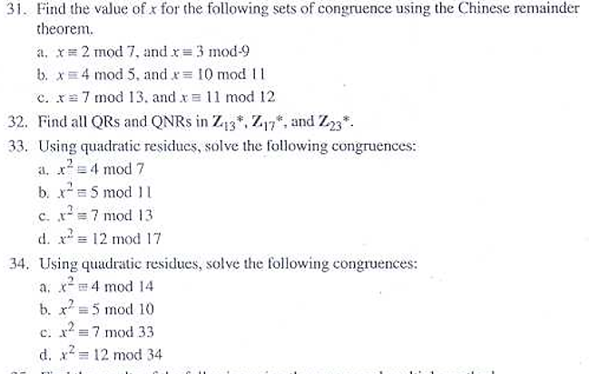
Home Work
9.<number>

